Slide 1

Python for QA
Python Basics. Part 2.

Slide 2
Control Flows
Notes:
Code blocks are defined by their indentation.

Slide 3
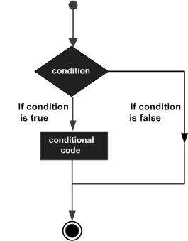
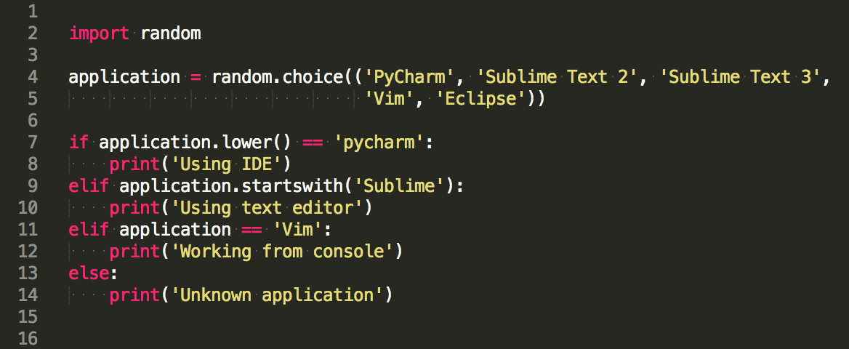
Decision Making
Notes:
if variable, if not variable, if variable is None:
indentation as blocks

Slide 4
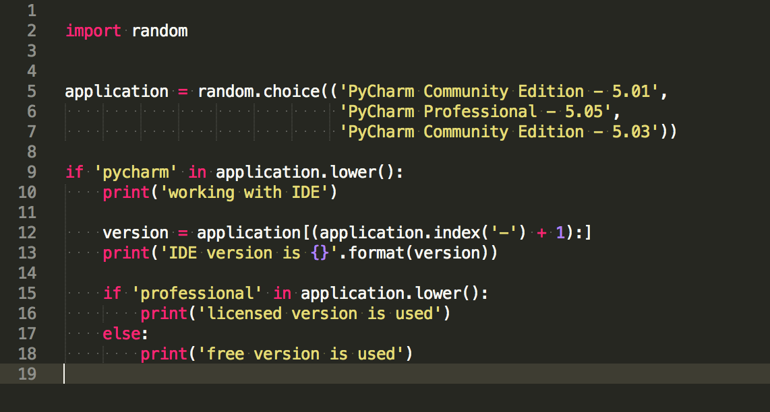
Blocks and pass

Slide 5
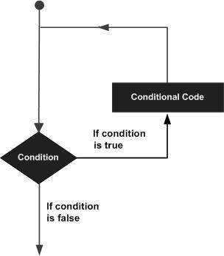
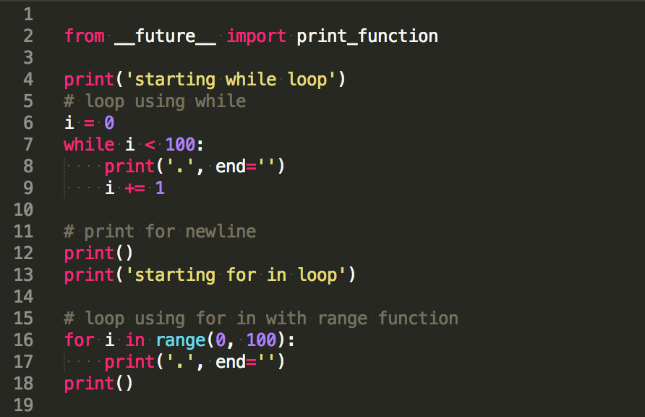
Loop
Notes:
range function

Slide 6
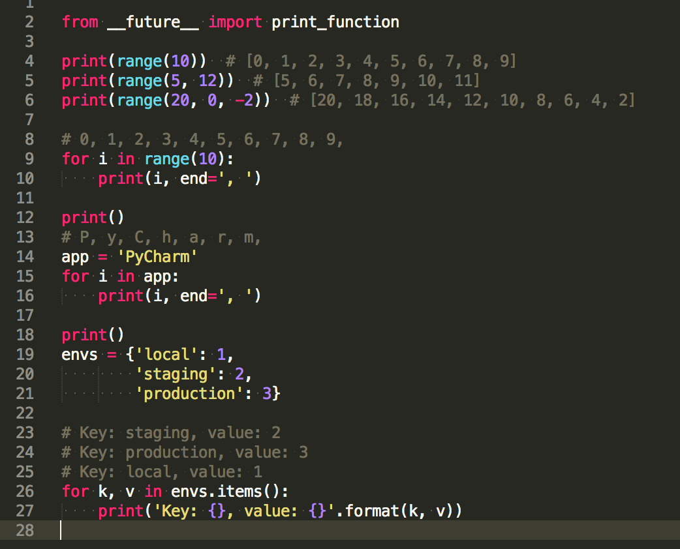
Looping Over
range()
looping over sequences
looping over dicts
Notes:
range function()

Slide 7
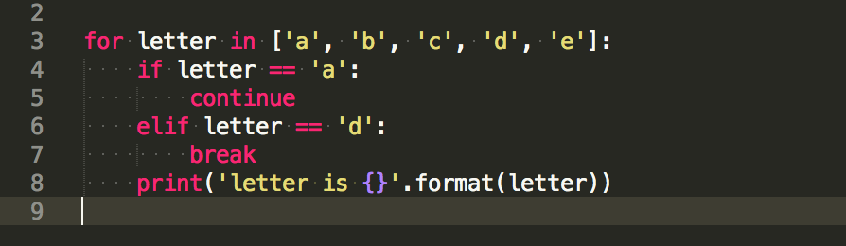
Loop Statements
Control Statement | Description
break | terminates loop
continue | skip the remainder of its body
Notes:
break, continue, else

Slide 8
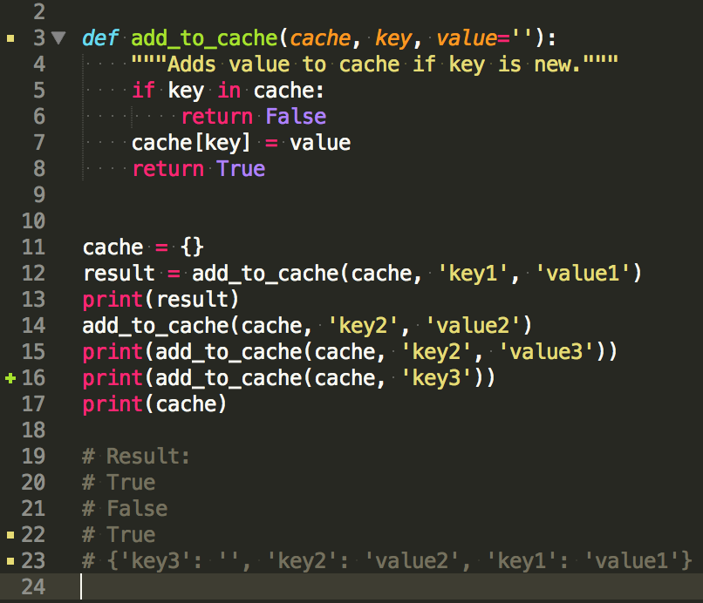
Functions
A function is a block of organized, reusable code that is used to perform a single, related action.
Define
Call
Pass by reference
Return value
Default argument’s value
Keyword arguments passing
Notes:
Scope
maybe global scope
http://www.tutorialspoint.com/python/python_functions.htm
function return
return could be use anywhere in function - in loop for example - this means - exit imeediately

Slide 9
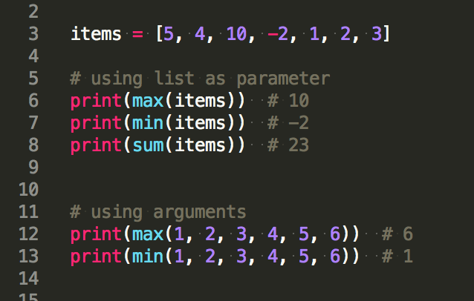
Min, Max, Sum
min() - return the smallest item in a sequence or the smallest of two or more arguments;
max() - return the largest item in a sequence or the largest of two or more arguments;
sum() - return the total of items in a sequence.
Notes:
Scope
maybe global scope
http://www.tutorialspoint.com/python/python_functions.htm
function return
return could be use anywhere in function - in loop for example - this means - exit imeediately

Slide 10
Practice
Conditions
simple if
show pass statement
if with else
if .. elif ..elif ..else
blocks of code
Loops
while
range function
for .. in
break and continue
looping over strings/lists/dicts
Functions
define function
call function
pass arguments
function result
required arguments
default arguments
keyword arguments
*args and **kwargs
Notes:
show pass statement

Slide 11
Code Style
always use 4 spaces for indentation
single quotes for strings
80 characters as line limit
PEP-8 Style Guide

Slide 12
Summary

Slide 13
Keywords
if..else
for..in
while
break, continue
def
pass
range

Slide 14
Practice
Write script to process excel file with opened bugs.
Remove duplicate bugs (80% words in description are the same)
Don’t count bugs from staging env
Print list with critical and high priority bugs
Calculate opened bugs count for each user
Use mapping for user’s nick and real names
Print most productive user
Notes:
data file https://docs.google.com/spreadsheets/d/1W0HNg_JS83PMIQg7uClcfDKpydzuWNsikF-j8dr3Z_4/edit#gid=0

Slide 15
Useful
Control Flows
Decision Making
Loops

Slide 16
Homework
Try to solve as much as possible tasks
Level 1 - 1 point
Level 2 - 2 points
Level 3 - 4 points
Please create task*.py file for each problem solution in directory lesson2-2, where * is task number.

Slide 17
Questions?

